Slide 1
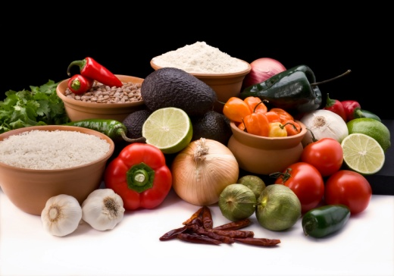
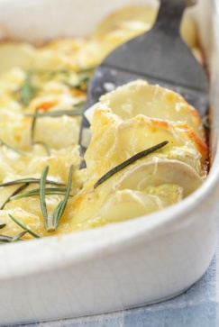
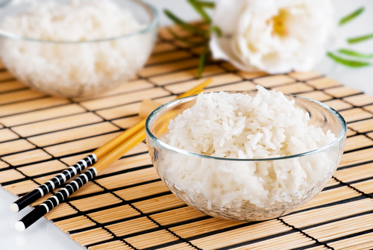
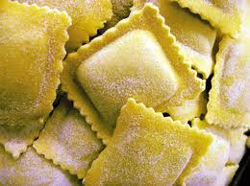
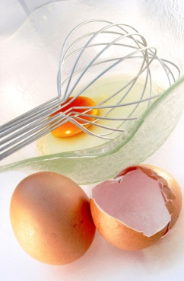
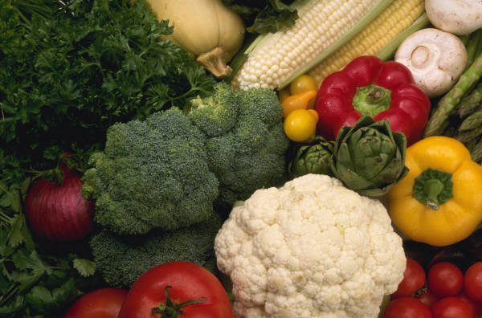
PREPARE VEGETABLES, EGGS AND FARINACEOUS DISHES
D1.HCC.CL2.18
Notes:
Welcome Students to the class
Discus with Students your bone fide to lecture on this subject
Discuss you qualifications in the culinary fields of cooking and teaching background

Slide 2

Prepare vegetables, eggs and farinaceous
Assessment for this Unit may include:
Oral questions
Written questions
Work projects
Workplace observation of practical skills
Practical exercises
Formal report from employer or supervisor
Notes:
Trainer to Advise:
Trainer advises students that assessment for this Unit may take several forms all of which are aimed at verifying they have achieved competency for the Unit as required.
Trainer indicates to students the methods of assessment that will be applied to them for this Unit.

Slide 3
Prepare vegetables, eggs and farinaceous
This unit comprises four elements:
1
Prepare and cook vegetable and fruit menu items
2
Produce and cook egg based menu items
3
Prepare and cook farinaceous menu items
4
Store vegetable, fruit, egg and farinaceous items
Notes:
Trainer to Advise:
Trainer advises students this Unit comprises four elements, as listed on the slide explaining:
Each Element comprises a number of Performance Criteria which will be identified throughout the class and explained in detail
Students can obtain more detail from their Trainee Manual
The course presents advice and information but where their workplace requirements differ to what is presented, the workplace practices and standards must be observed.

Slide 4
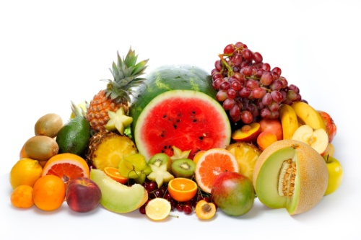
Prepare vegetables, eggs and farinaceous
Element 1: Prepare and cook vegetable and fruit menu items
Select vegetables and fruits according to availability
Prepare and cook a variety of vegetable and fruit menu items
Identify and prepare appropriate sauces, garnish and accompaniments as per the menu item
Present vegetable and fruit menu items
Notes:
Trainer to Advise:
Trainer to relate performance criteria to element 1
Performance criteria is the process by which the students training match the learning element
The element is the skill
To assess competency in the skill; the performance criteria is used to outline activities that can be used to assess competency.
The trainer should relate how the performance criteria is related to the element
To be able to Prepare vegetable eggs and farinaceous dishes the students must be able to;
Prepare and cook vegetable and fruit menu items:
Select vegetables and fruits according to availability
Prepare and cook a variety of vegetable and fruit menu items
Identify and prepare appropriate sauces, garnish and accompaniments as per the menu item
Present vegetable and fruit menu items

Slide 5
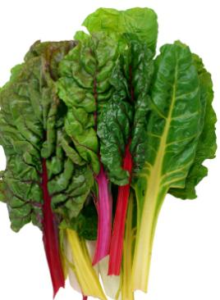
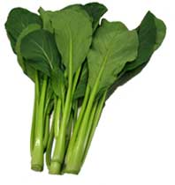
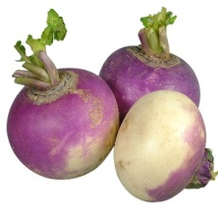
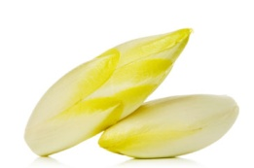
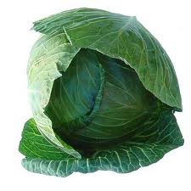
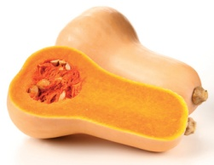
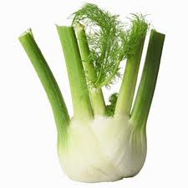
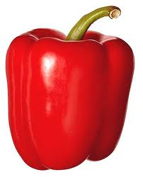
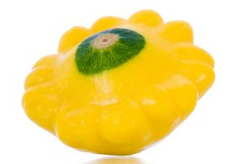
Prepare vegetables, eggs and farinaceous
Select vegetables and fruits due to availability
Vegetables and fruits:
Available all year
Seasonal:
Available for part of year
Fresh produce selection is guided by the above
Notes:
Trainer to Advise:
Catering establishments need to be aware of the availability of produce to be able to offer the BEST that the market place has to offer; to their customers
Is the establishment selling to tourist market and supplying western style foods from foreign countries
Supplying local foods in local dishes to both local and foreign customers
Some vegetables are available all year round
Some are seasonal
Some local, some from other parts of the country and the rest will have to be imported by land, air or sea

Slide 6
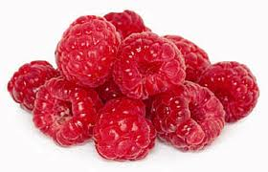
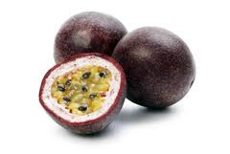
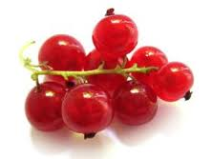
Prepare vegetables, eggs and farinaceous
Select vegetables and fruits due to availability
Fruits and Vegetables
Can be:
Fresh
Frozen
Dried
Canned
Notes:
Trainer to Advise:
Alternatives can be found from other medium rather than fresh
What does the enterprise wish to use
All fresh
All canned
All frozen
Most establishments will have a mixture
Fresh that is supplemented with frozen followed by canned and dried depending on the dish and the preference of the enterprise management and chef

Slide 7
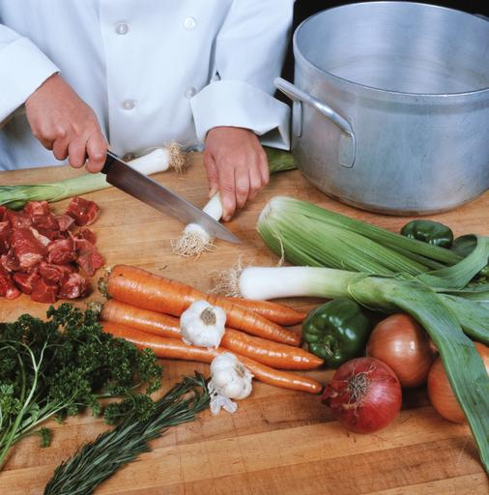
Prepare vegetables, eggs and farinaceous
Prepare and cook a variety of vegetable and fruit menu items
Vegetables can be:
Boiled
Steamed
Braised
Baked
Deep fried
Microwaved
Notes:
Trainer to Advise:
Root vegetables can be boiled roasted or baked
Leafy vegetables are best quickly blanched then served
Other vegetables are best cooked gently in water until texture is at a state that makes them palatable as per recipe requirements

Slide 8
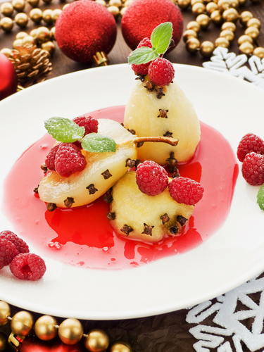
Prepare vegetables, eggs and farinaceous
Prepare and cook a variety of vegetable and fruit menu items
Fruits can be:
Poached
Stewed
Baked
Deep fried
Microwaved
Notes:
Trainer to Advise:
Fruits can be eaten raw or cooked
Many fruits require minimal cooking
Soft fruits are best eaten fresh
Hard fruits like apples and quinces need to be cooked and may require sweetening agent added to improve flavour: sugar
Spices can be used to enhance flavours
Deep frying allows for textural variety in dish with flavour from cooking method and keeping flavour of fruit in original state; Apple fritters with ice cream
Fruits that are baked in pastry have to be cooked before going into the pastry shell
Fruits contain much water and hard structural cell that needs to be softened before
Water leaching out of the fruit will make the party soggy and spoil the product

Slide 9
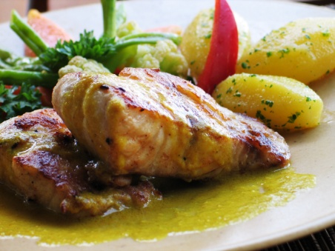
Prepare vegetables, eggs and farinaceous
Identify and prepare appropriate sauces, garnishes and accompaniments as per menu items
Classical dishes will have classical sauces
Sauces for French cuisine dishes are butter based
Melted butter added while hot
Some are milk based starch thickened with butter added for flavour and richness
Some are acidic egg yolk mixtures emulsified with melted butter
(continued)
Notes:
Trainer to Advise:
Sauces can be technically complicated or simple
This is defined by the dish that is being prepared

Slide 10
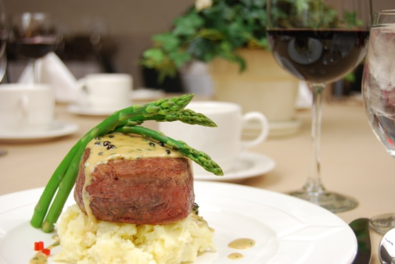
Prepare vegetables, eggs and farinaceous
Identify and prepare appropriate sauces, garnishes and accompaniments as per menu items
Simple Example of sauce:
Potato and carrots maybe boiled or steamed
Tossed in hot butter and served with garnish of herb
Complex example of sauce:
Asparagus steamed or quickly blanched
Plated and topped with Sauce Hollandaise
Notes:
Trainer to Advise:
Classical dishes will have classical sauces
Modern dishes will have tasty sauces that are uncomplicated
Sauces can be simple
Garnishes should be simple and easy to prepare

Slide 11
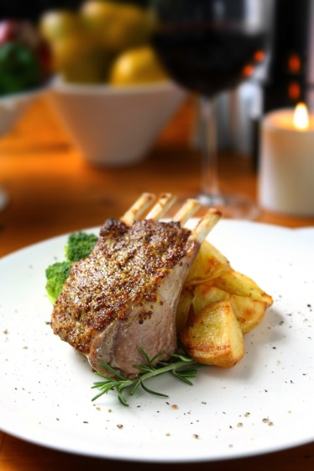
Prepare vegetables, eggs and farinaceous
Present vegetable and fruit menu items
Simple presentation is best
Diversity of colour on plate
Freshest is best
Contrast of mouthfeel
Starch based: potato, pumpkin, yam, sweet potato
Leaf based: spinach, brussells sprouts
Stem based: beans, peas
Root vegetables: carrots
Notes:
Trainer to Advise:
Keep presentations simple
Use colour to best advantage
Keep it simple
Keep it interesting

Slide 12
Prepare vegetables, eggs and farinaceous
Element 2: Prepare and cook egg based menu items
1
Prepare, use and or cook a variety of egg menu items
Identify and prepare appropriate sauces, garnishes and accompaniments as per the menu item
2
3
Present egg menu items
Notes:
Trainer to Advise:
Trainer to relate performance criteria to element 2
Performance criteria is the process by which the students training match the learning element
The element is the skill
To assess competency in the skill; the performance criteria is used to outline activities that can be used to assess competency.
The trainer should relate how the performance criteria is related to the element
To be able to Prepare vegetable eggs and farinaceous dishes the students must be able to;
Prepare and cook vegetable and fruit menu items:
Select vegetables and fruits according to availability
Prepare and cook a variety of vegetable and fruit menu items
Identify and prepare appropriate sauces, garnish and accompaniments as per the menu item
Present vegetable and fruit menu items

Slide 13
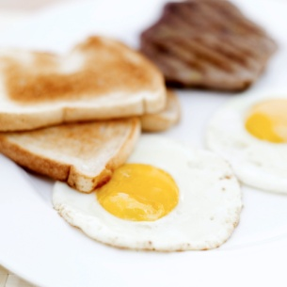
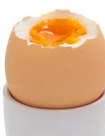
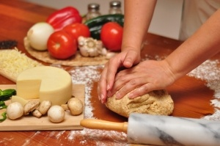
Prepare vegetables, eggs and farinaceous
Prepare, use and cook a variety of egg dishes
Breakfast:
Boiled
Fried
Scrambled
Poached
Omelets
Notes:
Trainer to Advise:
Eggs used are Egg of the chicken. Other eggs can be used but that is up to the individual
Eggs can be conveniently boiled in the shell. But when placed into cold water at room temperature and cooked until boiling
Too much boiling will cause the dark blue sulphur ring to appear at edge of yolk and spoil the look of the cut boiled egg
All other methods of cooking eggs require them to be removed from the shell.
Care must be taken to exclude any broken bits of shell being allowed to remain in egg while it is cooking
Shell in cooked egg can be dangerous if consumed. Larger pieces getting caught un throat of consumer. Smaller gritty pieces leave a uncomfortably feeling in mouth when ground in teeth. These customers will not be back
Fried and poached are popular ways to serve eggs.
Poached being the gentlest way to cook eggs
Classic Eggs Benedict with sauce Hollandaise; gently poached eggs 80ºC – 90ºC until egg white has set; should be soft but completely white;
Fried eggs are faster form of cooking and go well with bacon. Eggs and bacon on toast; popular in western countries as breakfast food
Scrambled eggs requires all egg to be blended until the white and the yolk cannot be distinguished; cooked gently over low heat until coagulation; this gives a soft mouth feel when eating. Overcooking will result in hard well set protein in mouth
Omelets have several derivations but classic French is cooked quickly in hot buttered pan and folded either side to have cigar shape and turned onto plate with seal folds underneath. Center of omelets should be ‘bavause’; which means soft moist and slightly runny inside; should be moist mouth feel but set.

Slide 14
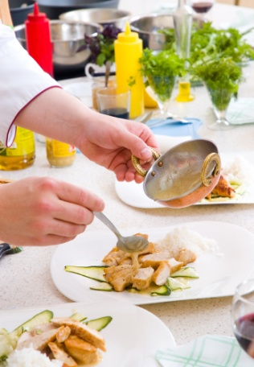
Prepare vegetables, eggs and farinaceous
Identify and prepare appropriate sauces, garnishes and accompaniments as per menu items
Classical sauces:
Hollandaise over poached eggs
Basic:
Melted butter over omelets
Adds moisture and richness to taste
Freshly chopped herbs
Notes:
Trainer to Advise:
Breakfast eggs should be plain, simple, uncomplicated.
The more intricate techniques need to be kept for a time when customers have time to sit and wait for proper technique to be carried out.
Eggs for breakfast have to be cooked in minimal time especially in establishments that cater for the working people rushing off to begin the days work
More formal breakfast that are for business people have time on their side so more technique can be used but his extra time taken is more costly.
Sauces kept to minimum. Very few breakfast egg dishes have complicated sauces, if any.
Garnishes are also kept to minimum; freshly chopped herbs, parsley, is the most common.

Slide 15
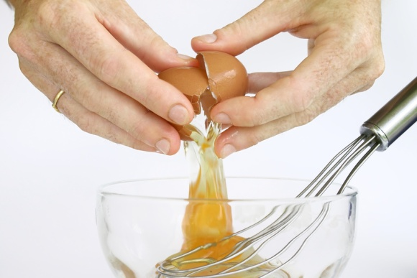
Prepare vegetables, eggs and farinaceous
Present egg menu items
Breakfast dishes:
Poached
Scrambled
Omelets
Lunch menu:
Frittata
Quiche
Dinner menu:
Soufflé
Notes:
Trainer to Advise:
Breakfast dishes are served quickly and simply
Lunch menu is again casual but more complex dishes may be offered; Frittata; Spanish omelets; Quiche
Frittata can prepare the day before and served cold with salad
Quiche; French open savoury tart uses eggs in milk and cream to carry fillings.
Theses can be served hot or cold; cold is popular as it can be consumed with ease. Too higher a fat content can require this to be served warm for more palatable enjoyment.
Dinner menu may find eggs in béarnaise sauce with beef steak or in dessert soufflé

Slide 16
Prepare vegetables, eggs and farinaceous
Element 3: Prepare and cook farinaceous menu items
1
Select farinaceous items according to availability
2
Prepare and cook a variety of farinaceous menu items
Identify and prepare appropriate sauces, garnish and accompaniments as per the menu item
3
4
Present farinaceous menu items
Notes:
Trainer to Advise:
Trainer to relate performance criteria to element 3
Performance criteria is the process by which the students training match the learning element
The element is the skill
To assess competency in the skill; the performance criteria is used to outline activities that can be used to assess competency.
The trainer should relate how the performance criteria is related to the element
To be able to Prepare vegetable eggs and farinaceous dishes the students must be able to;
Prepare and cook farinaceous menu items:
Select farinaceous items according to availability
Prepare and cook a variety of farinaceous menu items
Identify and prepare appropriate sauces, garnish and accompaniments as per the menu item
Present farinaceous menu items

Slide 17

Prepare vegetables, eggs and farinaceous
Select farinaceous items according to menu items
Every menu in every country contain farinaceous:
Rice
Pasta
Noodles
Lentils
Breads
Root vegetables
Notes:
Trainer to Advise:
Farinaceous means starch. Every person consumes starch in their meals.
The body converts the starch that we consume into sugars and that fuels the body and allows it to function.
Starch is in many foods and preparation of these foods give variety to the diet and choice to the consumer
To make the starch edible it must be cooked with or in water.
Starch is cooked by applying heat to liquid.
As the liquid heats the starch absorbs the moisture and expands fully to become edible for humans.
In bread this is already completed in the mixing and baking process so it can be consumed as it is.
Products like rice and lentils need to be cooked to make it palatable and edible. Cooked in aromatic liquids make them more appealing and flavoursome to consume
Noodles and pasta are a manufactured product that will have to be cooked before consumption. Like bread if it was unbaked.
Pasta and noodles need to be cooked in water until they have reached the stage of doneness required by the dishes cuisine. Some are firm to the tooth and some are well cooked until they are soft to the tooth.
Root vegetables like potato, pumpkin and yams are also cooked to the cuisine requirements but these can be dry cooked due to the high liquid content already in the vegetable. dry cooking is roasting or baking.

Slide 18
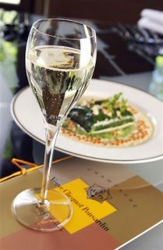
Prepare vegetables, eggs and farinaceous
Identify and prepare appropriate sauces, garnishes and accompaniments as per menu items
Sauces:
Highly flavoured spicy:
Curry base for lentils
Simple single flavours:
Béchamel base with cheese for mornay
Flavour
Moisture adding
Notes:
Trainer to Advise:
Starchy farinaceous products can be dry to eat on their own. Draws the moisture from the mouth as they are eaten so they are best served with a sauce to add moisture and make consumption more enjoyable
Lentils tend to be cooked in spicy or flavoursome liquids that have spices and some other aromatics like onion garlic and herbs added
Flavour bases can be manufactured and added to water that lentils will be cooked in until they are deemed cooked. Some are cooked firm while some lentils fall apart quickly to thicken the water. These are then served as a side accompaniment to main protein or as main meal for non meat eating societies
Béchamel is a savoury white sauce, milk thickened with starch and enriched with addition of butter. This is further flavoured with cheese to enhance desirability and sometimes a spice like nutmeg
This sauce is used in many western vegetable dishes. It can be poured over roasted root vegetables and glazed in hot under hot grill to gratin the top surface
Classic noodles dish is : Macaroni and cheese. A staple for working class people that needed to fill up growing children and hard working men on a low money budget
Sometimes served as a side accompaniment for diets that do not have potatoes and main sauce of starch.
All sauces need to be flavoursome and do add moisture to enhance the mouth feel of what people are consuming.
Garnishes can be chopped herbs

Slide 19
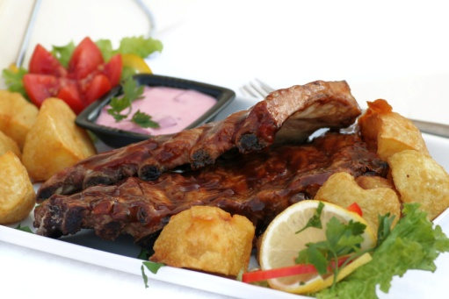
Prepare vegetables, eggs and farinaceous
Present farinaceous menu items
Potatoes:
Roasted, mashed, deep fried
Pasta noodles
Lentils and legumes
Notes:
Trainer to Advise:
Farinaceous elements or menu items can be individual serving or accompaniments to main protein menu item
All will need to be presented or served with a sauce; the sauce will be the main flavour for the farinaceous item
Farinaceous menu items do not necessarily have much flavour, that some from sauces with which they are served.
Root vegetables like potato need added moisture to enrich the flavour
Ask Students
They eating noodles with out sauce,,,,,,,, flavour is bland
Try eating rice without sauce,,,,,,,, bland
Lentils and chickpeas may have interesting textures but flavour is mild

Slide 20
Prepare vegetables, eggs and farinaceous
Element 4: Store vegetable, fruit, egg and farinaceous items
Store fresh prepared and or cooked vegetable, fruit, egg and farinaceous menu items correctly
1
Store fresh prepared and or cooked vegetable, fruit, egg and farinaceous products appropriately in correct containers
2
Label fresh prepared and or cooked vegetable, fruit, egg and farinaceous products correctly
3
Store fresh prepared and or cooked vegetable, fruit, egg and farinaceous products in correct conditions to maintain freshness and quality
4
Notes:
Trainer to Advise:
Trainer to relate performance criteria to element 4
Performance criteria is the process by which the students training match the learning element
The element is the skill
To assess competency in the skill; the performance criteria is used to outline activities that can be used to assess competency.
The trainer should relate how the performance criteria is related to the element
To be able to Prepare vegetable eggs and farinaceous dishes the students must be able to;
Store vegetable, fruit, egg and farinaceous items items:
Store fresh prepared and/or cooked vegetable, fruit, egg and farinaceous menu items correctly
Store fresh prepared and/or cooked vegetable, fruit, egg and farinaceous products appropriately in correct containers
Label fresh prepared and/or cooked vegetable, fruit, egg and farinaceous products correctly
Store fresh prepared and/or cooked vegetable, fruit, egg and farinaceous products in correct conditions to maintain freshness and quality

Slide 21
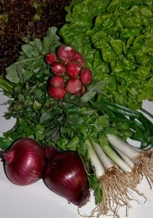
Prepare vegetables, eggs and farinaceous
Store fresh vegetables items
Clean environment
Clean containers
Environment suitable for maximum storage life
Fresh
Frozen
Canned or dried
Notes:
Trainer to Advise:
All fresh vegetables are perishable in a very short time
Root vegetables alike potato, yams and pumpkin need to be stored in a cool environment that needs to be well ventilated. Not refrigerated
Fresh leafy vegetables need to be kept chilled to prolong their life; 3-4 days
Store at less than 5ºC, keep covered with plastic to stop from drying the leafy vegetables and help retain moisture
Some vegetables can be stored can be stored well between 7 and 15ºC
Best is to store for minimum period by purchasing on a daily basis what is required for the days trading
Canned vegetables need to be stored in environment that will not be detrimental to safe can storage; cool well ventilated dry environment
Frozen vegetables need constant -18ºC storage for consistency, when thawed they must be used immediately
Frozen potato (French fries) are placed into deep fryer while still frozen so must be kept that way

Slide 22
Prepare vegetables, eggs and farinaceous
Store cooked vegetable items
Chilled, below 5ºC
Clean containers
Keep covered
Date
Rotate stock on FIFO basis
Maximum 2 days
Notes:
Trainer to Advise:
Any cooked vegetables needs to be chilled if they are going to be stored.
Storage must be at less than 5ºC for no more than 2 days
Containers must be clean and in good conditions
Stored vegetables must be labeled correctly
Keep stock rotation up to date

Slide 23
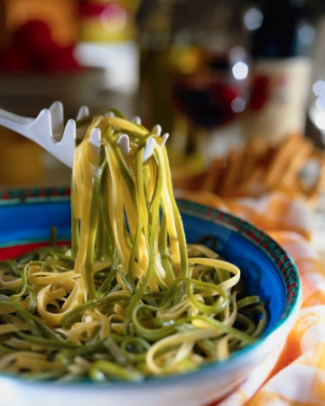
Prepare vegetables, eggs and farinaceous
Store cooked farinaceous items
Chilled, below 5ºC
Clean containers
Keep covered
Date
Rotate stock on FIFO basis
Maximum 2 days
Notes:
Trainer to Advise:
Any cooked farinaceous products need to be chilled if they are going to be stored.
Storage must be at less than 5ºC for no more than 2 days
Containers must be clean and in good conditions
Stored product must be labeled correctly
Keep stock rotation up to date

Slide 24
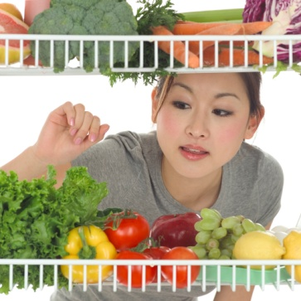
Prepare vegetables, eggs and farinaceous
Store fresh farinaceous items
Chilled, below 5ºC
Clean containers
Keep covered
Date
Rotate stock on FIFO basis
Maximum 2 days
Freeze if longer storage is required
Notes:
Trainer to Advise:
Any fresh farinaceous products need to be chilled if they are going to be stored before cooking
Storage must be at less than 5ºC for no more than 2 days
Longer exposure may result in oxidation in flour resulting in grey flecks appearing in uncooked flour based product
Containers must be clean and in good conditions
Stored product must be labeled correctly
Keep stock rotation up to date

Slide 25
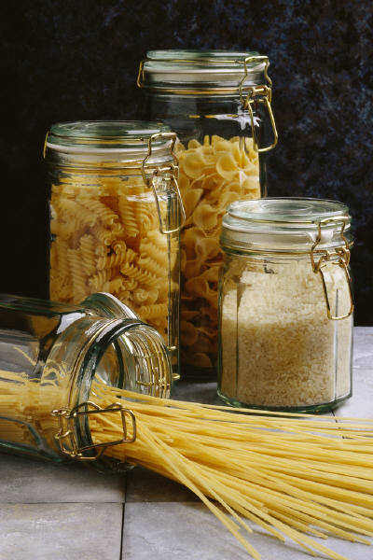
Prepare vegetables, eggs and farinaceous
Store dry farinaceous items
Clean containers
Keep in original packaging until required
Place left over dry product into sealed container
Do not leave exposed
Date
Rotate stock on FIFO basis
Notes:
Trainer to Advise:
Dry product can be kept stored for long periods of time
Precautions with moisture must be undertaken
Any dry product that get water damaged must be discarded due to risk of mould growth
Keep stored off floors
If packaging is damaged product needs to be de-cantered into secure container to prevent infestation with pests

Slide 26

Prepare vegetables, eggs and farinaceous
Store fresh fruit
Chilled, below 5ºC
Clean containers
Keep covered
Date
Rotate stock on FIFO basis
Time frame changes for specific fruits
Notes:
Trainer to Advise:
All fruits need to be stored in secure areas
Bananas may be stored in at room temperature as can other fruits
Fresh berries will have a short life if not chilled and mould will grow rapidly
Dried fruits will keep well if moisture is kept away, so packaging must be secure

Slide 27
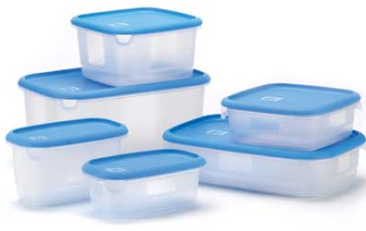
Prepare vegetables, eggs and farinaceous
Store in appropriate containers
Clean
In good repair
Able to be sealed if required
Must not cause damage to stored product
Notes:
Trainer to Advise:
Product is stored for one reason
To be used at a later date
If placed into containers that are not clean to begin then the product may as well have been thrown in rubbish and not stored
Containers must be clean and in a good state of repair so pests are not able to enter and moisture cannot enter
Containers must be able to be closed and sealed if required
Closing the containers must not damage the product being stored

Slide 28

Prepare vegetables, eggs and farinaceous
Label containers appropriately
Easily read and definition of product clear
In common language understood by all
Name of product
Date of manufacture
Use by date
Notes:
Trainer to Advise:
Labeling needs to be clear and defined
Must be legible
Must include:
Name of product
Date of manufacture
Use by date
Person who packed or labeled product
Name of manufacturer

